Slide 1
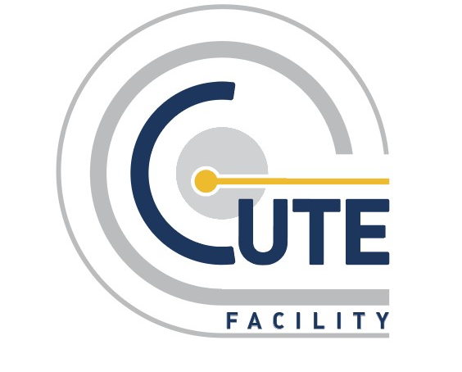

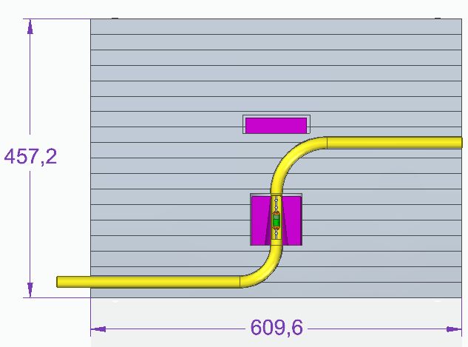
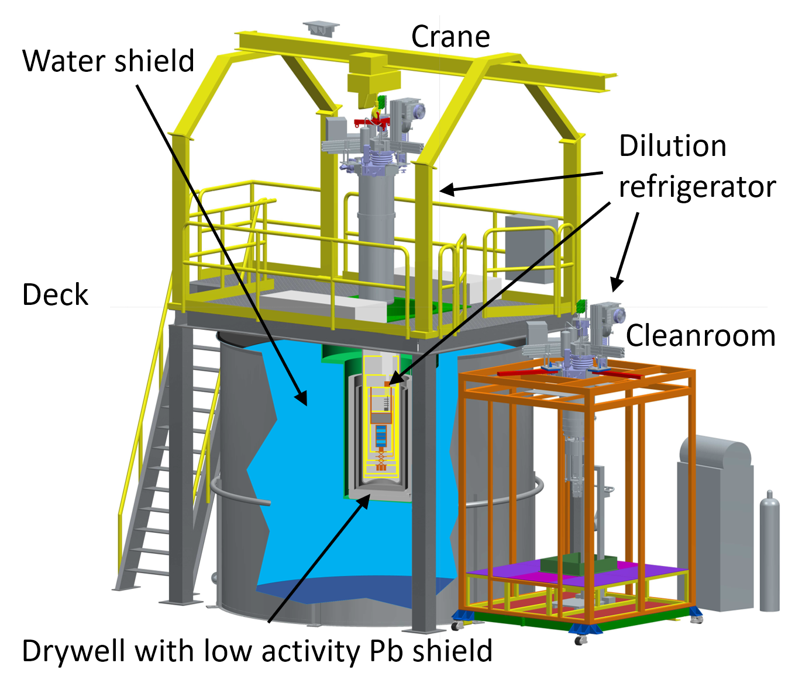
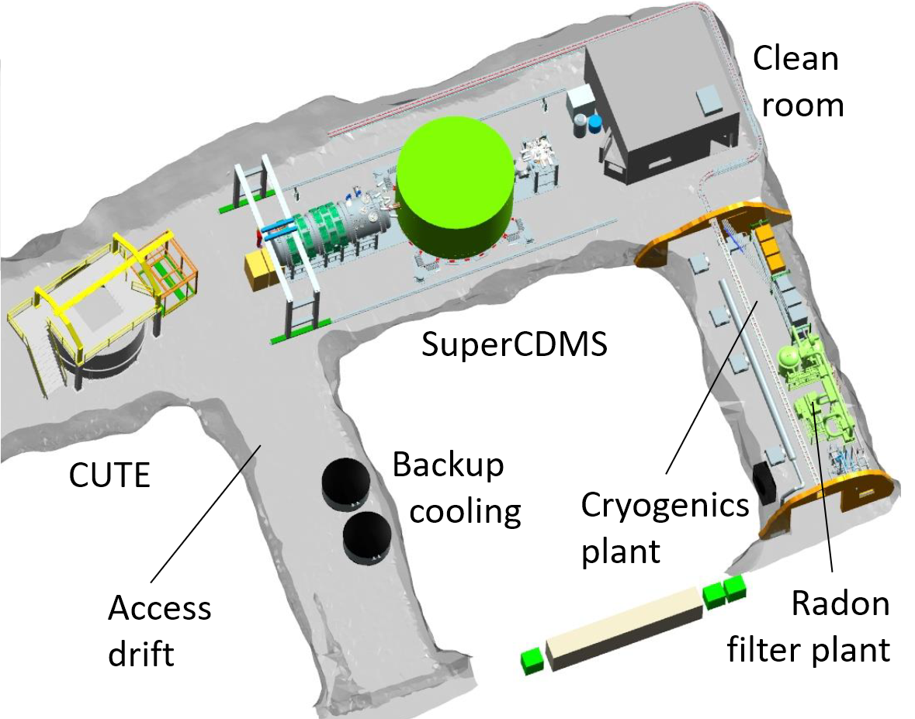
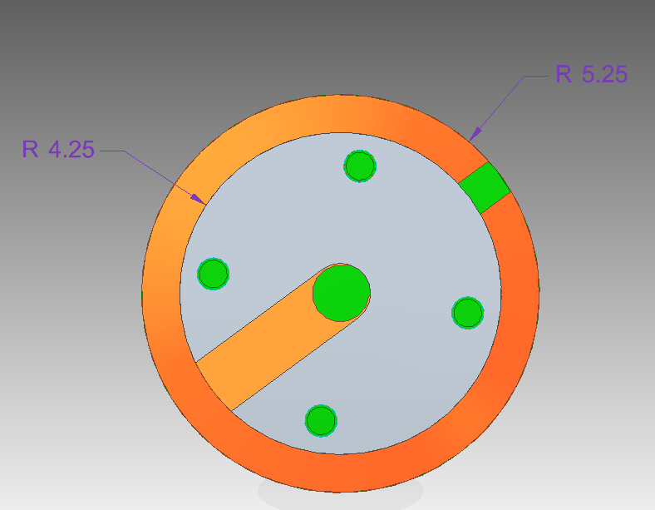
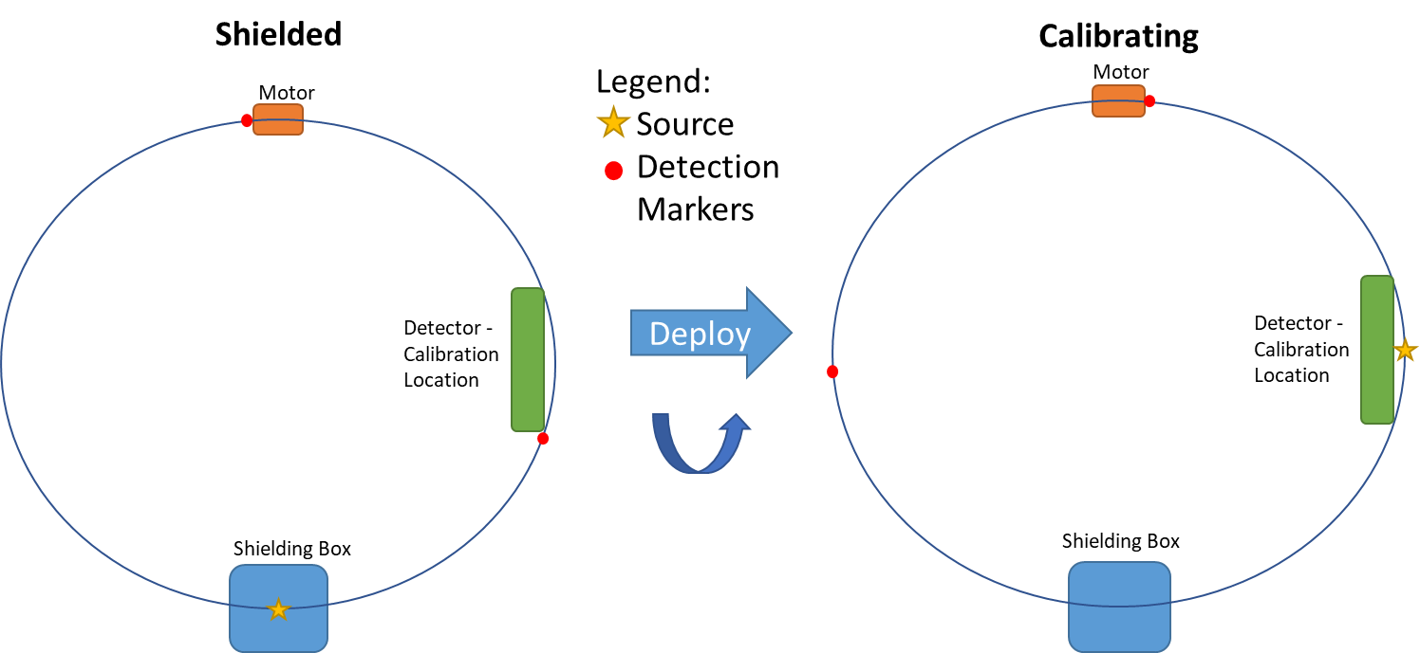
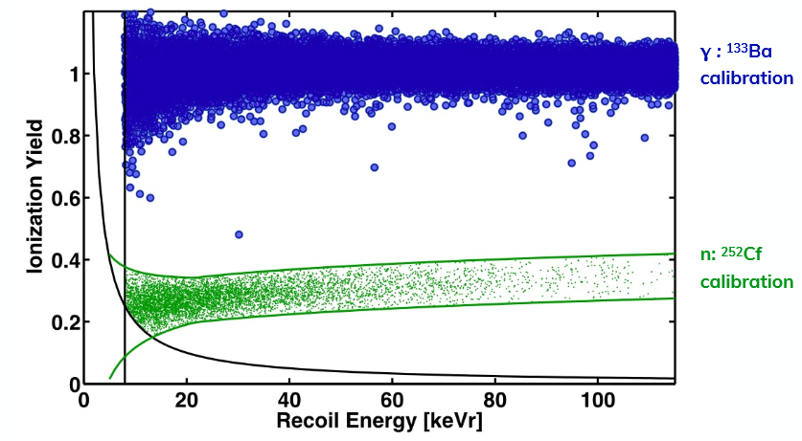
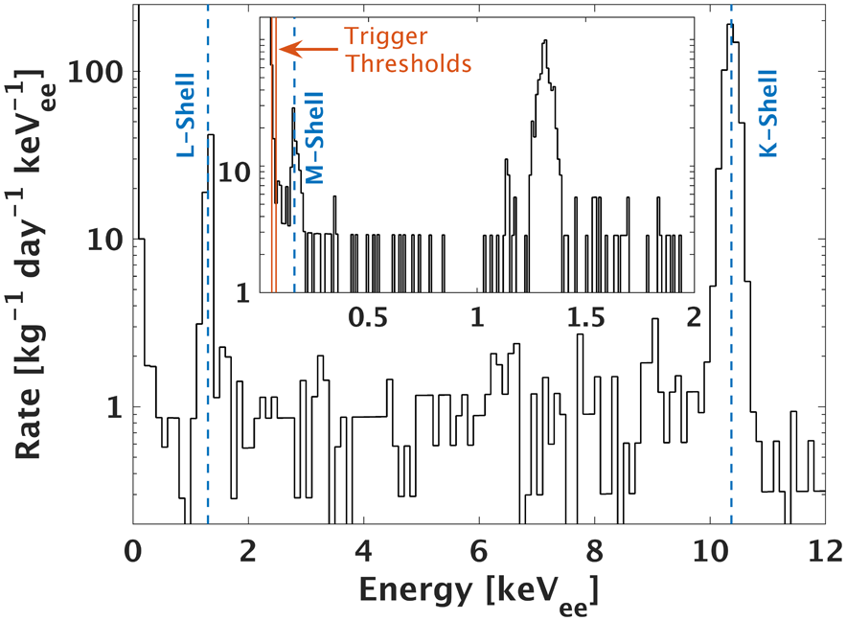
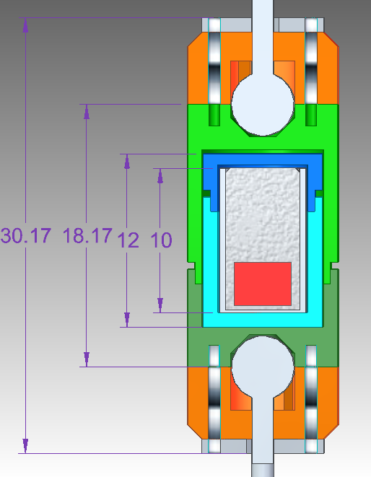
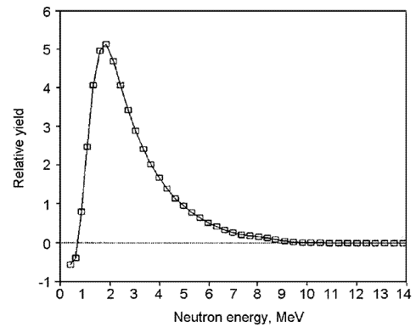
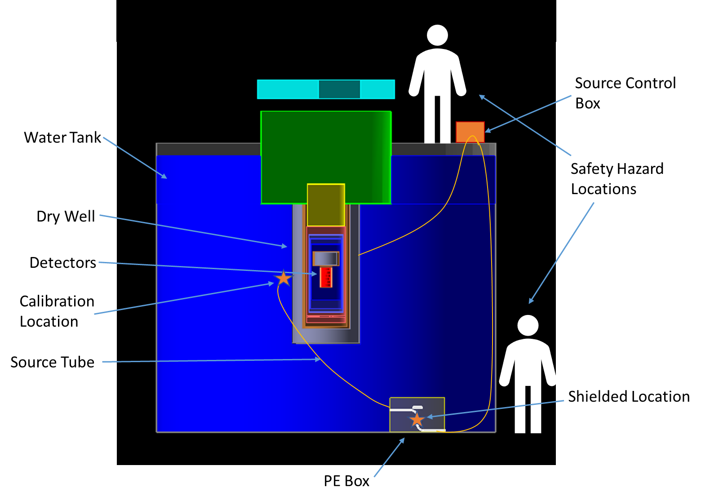
A Neutron Calibration System for the Cryogenic Underground Test facility (CUTE)
Jonathan Corbett for the CUTE Team
Department of Physics, Engineering Physics, and Astronomy at Queen’s University
Abstract
SuperCDMS is an experiment that aims to probe the low mass region of the Dark Matter candidate called the WIMP. As a means for verification and testing of the technology used in SuperCDMS, the Cryogenic Underground TEst (CUTE) facility is being developed. A neutron calibration system was designed to understand how the SuperCDMS detectors will respond to nuclear recoils of known particles. The novelty of the proposed design is that it allows for the neutron source to be contained within the experimental setup of CUTE, and remotely controlled to deploy the source.
CUTE at SNOLAB
Technical Design
The Cryogenic Underground TEst (CUTE) facility will be used to test detectors for the Super Cryogenic Dark Matter Search experiment (SuperCDMS) at SNOLAB, a low background underground laboratory located in Sudbury, Canada [1,2].
Shielding Box:
At the bottom near the edge of the water tank sits a polyethylene box shielding the source neutrons even in absence of the water. The source guide tube forms an S-curve inside the box, avoiding lines of sight from the storage location to the outside. The storage location is surrounded by HeavyMet (W-alloy) and Pb to shield from gammas.
Lead Bricks
R = 80mm
HeavyMet
Encapsulated
Source
R = 60mm
Figure 1: The CUTE facility: A monorail crane is used to lift the dilution refrigerator from the cleanroom into the shielded drywell in the water tank
Figure 2: CUTE facility is located at SNOLAB next to the SuperCDMS setup
Figure 6: Cross Section of the PE shielding box, showing the gamma shields (purple) and the source guide tube (yellow)
Design Considerations
Source:
The ~20 kBq ²⁵²Cf source is doubly encapsulated (mandated by SNOLAB source policy). The capsule also provides the mechanical connection to the chain that moves the source.
Calibrations are important to understand the detector response
SNOLAB policy to protect sensitive experiments requires minimum 1 week notice for moving a neutron source
Design a remote controlled system contained within experimental setup, while maintaining low exposure outside for personnel and neighbouring experiments
Figure 8: Block diagram of the full looped chain method for source deployment and location tracking. The arrow indicates the direction the loop would turn to deploy the source. Chain markers act as a secondary detection method since they appear at the motor box when the source is at the important locations.
Location Detection:
A stepper motor moves the source which is attached to a closed-loop chain to pull it through the guide tube. Location markers on the chain limit the motion to between storage and calibration locations.
Figure 3: Example plot of the ionization yield vs. recoil energy expected for electronic recoils and nuclear recoils from two different calibration sources
Figure 4: ⁷¹Ge decay (top) spectrum and ²⁵²Cf neutron energy spectrum (bottom) [3][4]
Figure 7: Source Encapsulation Design. Shown are the active volume (red), encapsulation from manufacturer (silver), two-layer encapsulaton (blue/green), attachment (orange) with washer (grey) for beaded chain (white).
Simulation Results
The design of the shielding was implemented into GEANT4 [5] and a Monte Carlo simulation of the ²⁵²Cf source in various locations was performed. From the flux of particles leaving the water tank and those arriving at various cavern surfaces, the safety of the system, and background it would produce for nearby experiments were evaluated.
Status and Outlook
- Conceptual design complete
- Technical design advanced (work needed on stepper motor holder, location sensor)
Design validated for safety (personnel/other experiments) and rate detector rate by GEANT4 simulations
Documents for approval by SNOLAB in preparation
Quote for source (²⁵²Cf, 18.5 kBq) from Eckert & Ziegler in hand
Production of shielding box has started
Figure 5: Rendering of the CUTE facility in GEANT4 with stand-in figures showing the locations of potential radiological hazard and starred locations for source calibration
References
Table 1: Summary of the simulation results. Maximum acceptable dose rate is 2.5μSv/hr for a shielded source at SNOLAB. SNOLAB Background numbers are dominated by the high radon levels underground [6][7]
[1] P. Camus et al., “CUTE: A Low Background Facility for Testing Cryogenic Dark Matter Detectors,” J. Low Temp. Phys. 193, 813-818 (2018) [Online]. Available: https://doi.org/10.1007/s10909-018-2014-0
[2] R. Agnese et al., “Projected sensitivity of the SuperCDMS SNOLAB experiment,” Phys. Rev. D, 95, 082002, (2017) [Online]. Available: https://doi.org/10.1103/PhysRevD.95.082002
[3] S.T. Park, “Neutron energy spectra of ²⁵²Cf, Am-Be source and of the D(d,n)³He reaction,” J. Radioanal. Nucl. Chem. 256, 163-165 (2003) [Online]. Available: https://doi.org/10.1023/A:1023333016692
[4] R. Agnese et al., “Low-mass dark matter search with CDMSlite”, Phys. Rev. D, 97, 022002, (2018) [Online]. Available: https://doi.org/10.1103/PhysRevD.97.022002
[5] S. Agostinelli et al., “Geant4—a simulation toolkit,” Nucl. Instrum. Methods A 506, 250-303 (2003) [Online]. Available: https://doi.org/10.1016/S0168-9002(03)01368-8
[6] Radiation Safety Committee, “Radiation Protection Program,” SNOLAB, Tech. Rep. 2017, Internal Document No: SL-MCS-EHS-60-001-P.
[7] International Commission on Radiological Protection (ICRP), “Calculating Radon Doses”, Pub. 126, para. 41-45. Available: http://icrpaedia.org/Calculating_Radon_Doses

